Slide 1
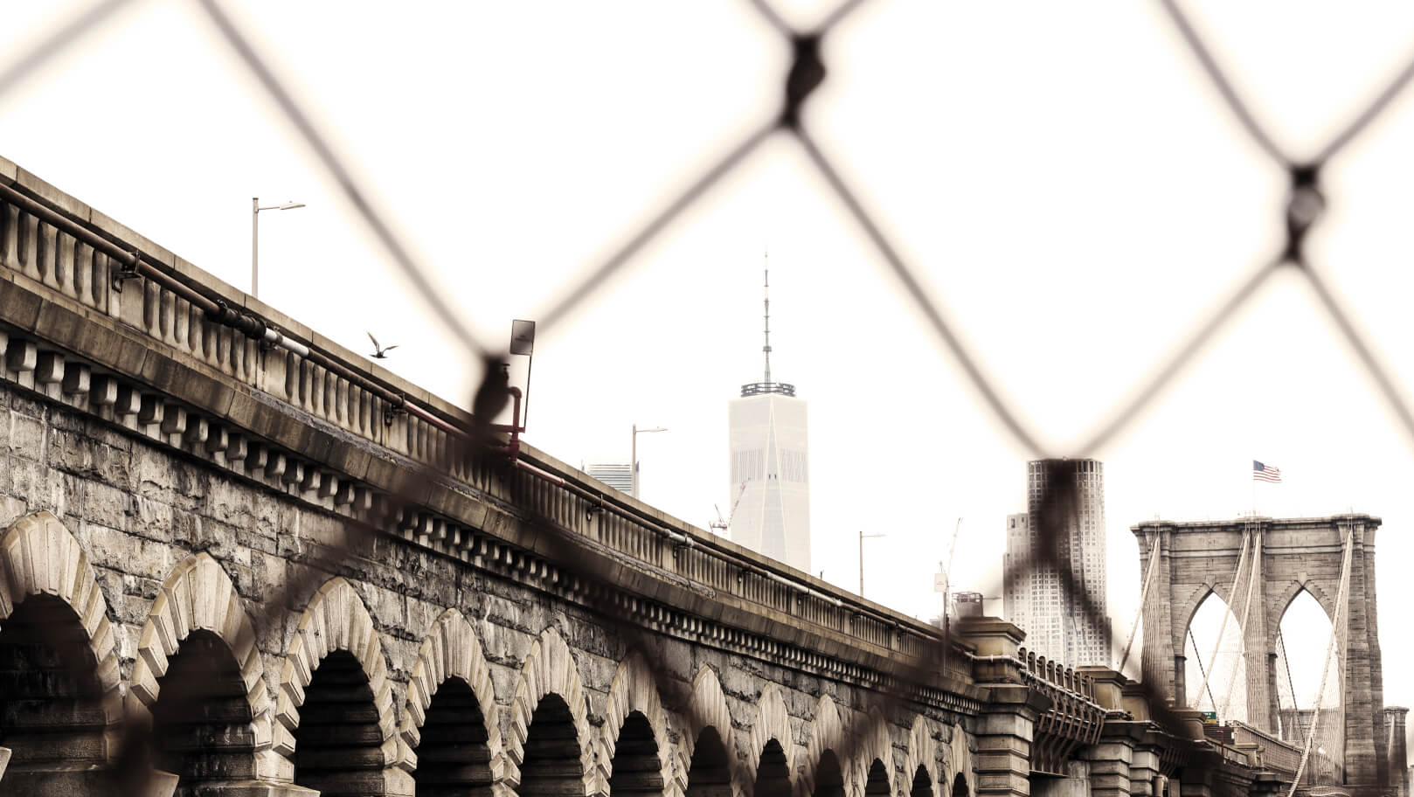
MAJOR REQUIREMENTS
01

Slide 2
MARS
JUPITER
SATURN
MAJOR REQUIREMENTS
MERCURY
NEPTUNE
VENUS
Despite being red, Mars is a cold place, not hot. It’s full of iron oxide dust
It’s a gas giant, the biggest planet in our Solar System and the fourth-brightest object in the sky
Yes, this is the ringed one. It’s a gas giant, composed of hydrogen and helium
Mercury is actually the smallest planet in our Solar System
Neptune is the fourth-largest planet in our Solar System and the farthest from the Sun
Venus has a beautiful name and is the second planet from the Sun. It’s terribly hot

Slide 3
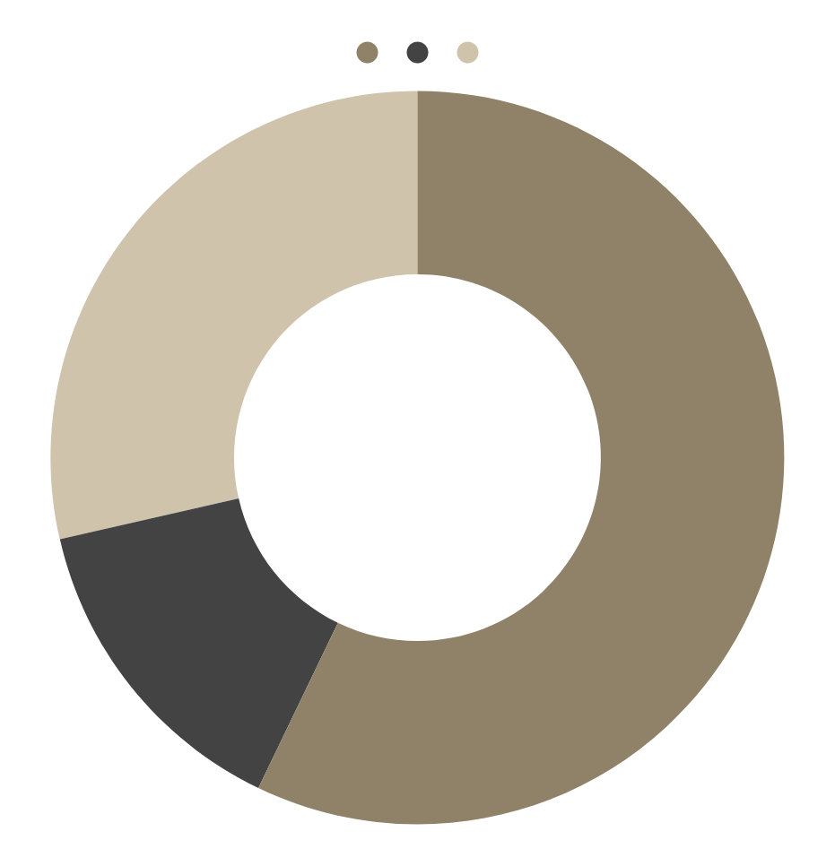
VENUS
30%
BUDGET
MARS
60%
MERCURY
10%
If you want to modify this graph, click on it, follow the link, change the data and replace it

Slide 4
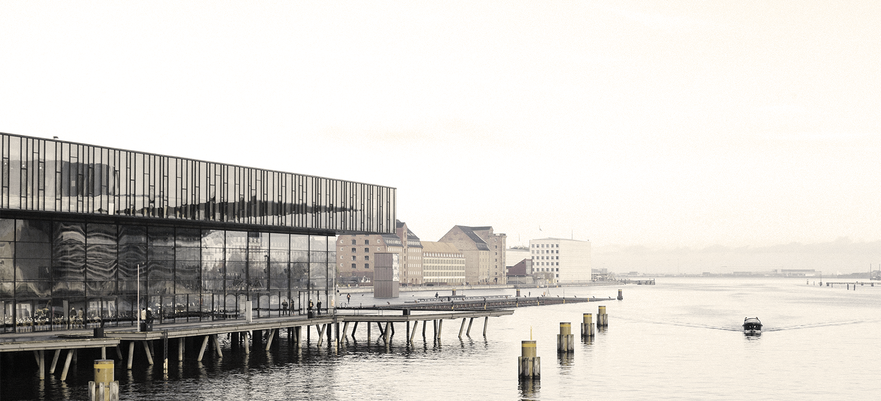
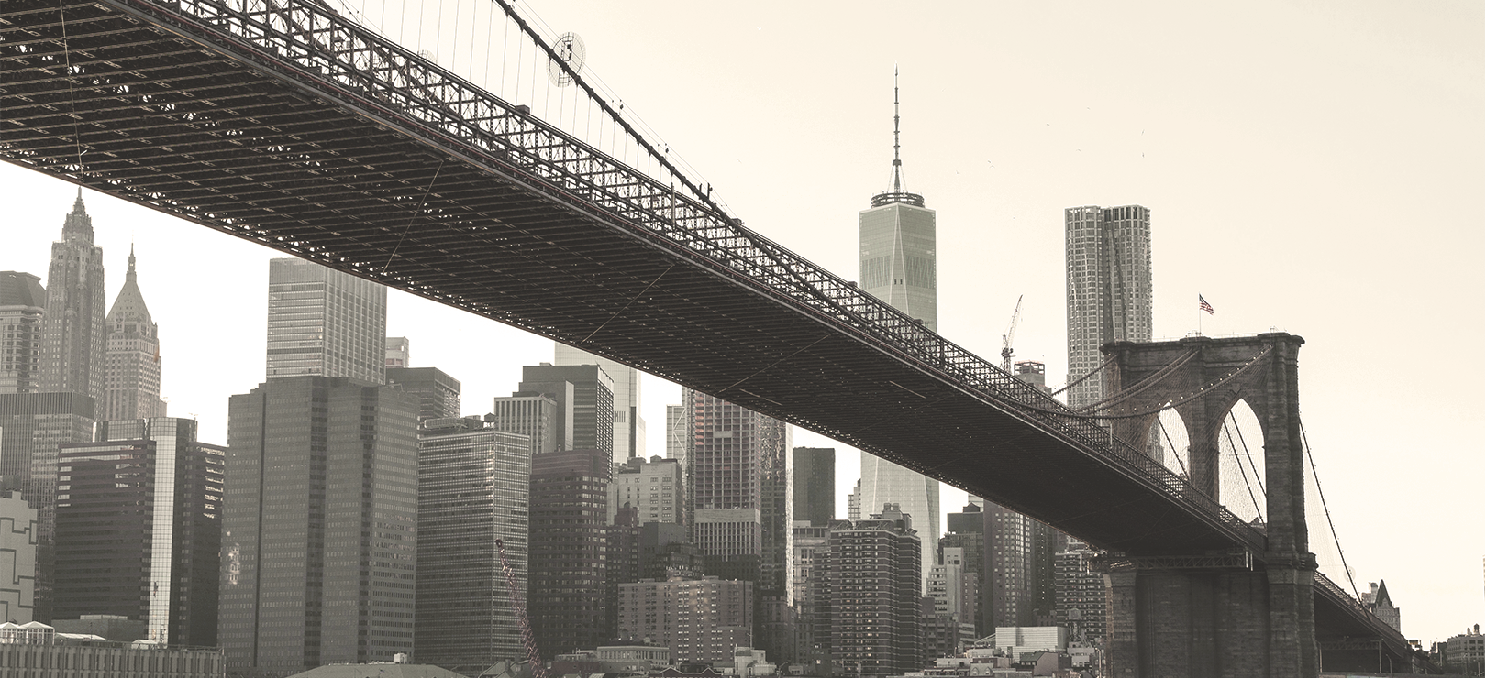
PROJECT GOALS
GOAL 1
GOAL 2
Mercury is the closest planet to the Sun and the smallest one in the Solar System—it’s only a bit larger than our Moon
Venus has a beautiful name and is the second planet from the Sun. It’s terribly hot, even hotter than Mercury

Slide 5
PREDICTED RESULTS
 | VENUS | MARS | MERCURY | JUPITER
AREA 1 | 50 | 100 | 20 | 30
AREA 2 | 23 | 34 | 45 | 56
AREA 3 | 234 | 45 | 65 | 56

Slide 6
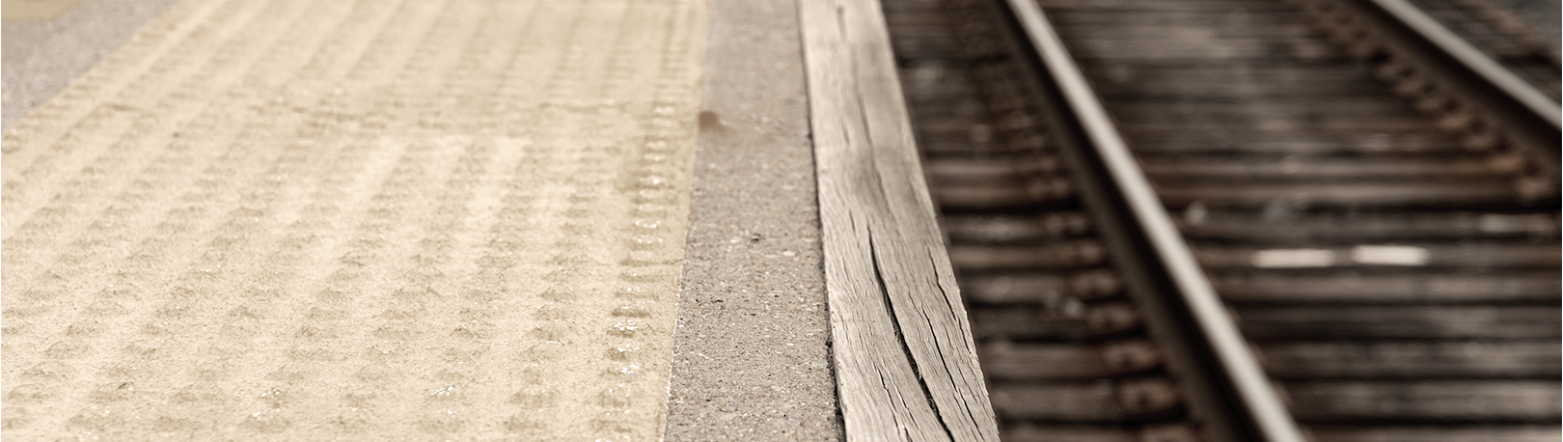
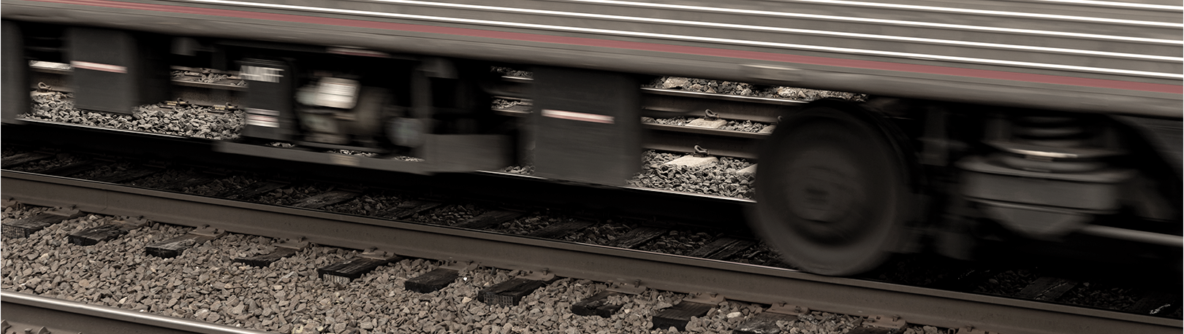

STAGE 1
PROJECT STAGES
STAGE 2
STAGE 3
Venus has a beautiful name and is the second planet from the Sun. It’s terribly hot
Mercury is the closest planet to the Sun and the smallest one in the Solar System
Despite being red, Mars is a cold place, not hot. It’s full of iron oxide dust, giving the planet its reddish cast

Slide 7
MERCURY
MARS
FUTURE PROJECTS
VENUS
SATURN
Mercury is the closest planet to the Sun and the smallest one in the Solar System
Despite being red, Mars is a cold place, not hot. It’s full of iron oxide dust
Venus has a beautiful name and is the second planet from the Sun
Saturn is the ringed planet. It’s a gas giant, composed mostly of hydrogen and helium

